Slide 1
Poker with Python
Joseph Urie – jgurie@syr.edu – CIS 467 Term Project

Slide 2
What is Machine Learning?
Machine learning explores the study and construction of algorithms that can learn from and make predictions on data. (Machine Learning, 1998)
Machine Learning has strong ties to mathematical optimization and computational statistics.
Computers learn from a given dataset and apply it to new problems.

Slide 3

MY Machine
The code for this project is written in Python 3.6.3.
Libraries included:
NumPy
Pandas
Sci-Kit Learn (Sklearn)

Slide 4
MY Machine (Cont.)
What is included in my project:
Term_project.py
Test.py
Poker Hand Data Set (Provided by UCI Machine Learning Repository)

Slide 5

Intro
Machine will identify the poker hand value of a random sample of 5 poker cards.
Data set includes a 25,010 entry training set, as well as a 1,000,000 entry test set.

Slide 6
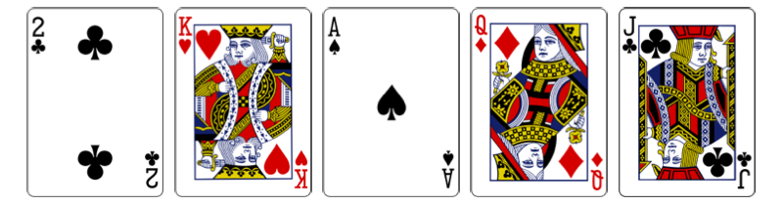
Poker Hand Entry
A poker hand is an array of 11 numbers
Even numbers: Card Suit (1-4)
Odd numbers: Card Rank (1-13)
11th number (0-9)
Hand [4, 2, 1, 13, 2, 1, 3, 12, 4, 11, 0]

Slide 7
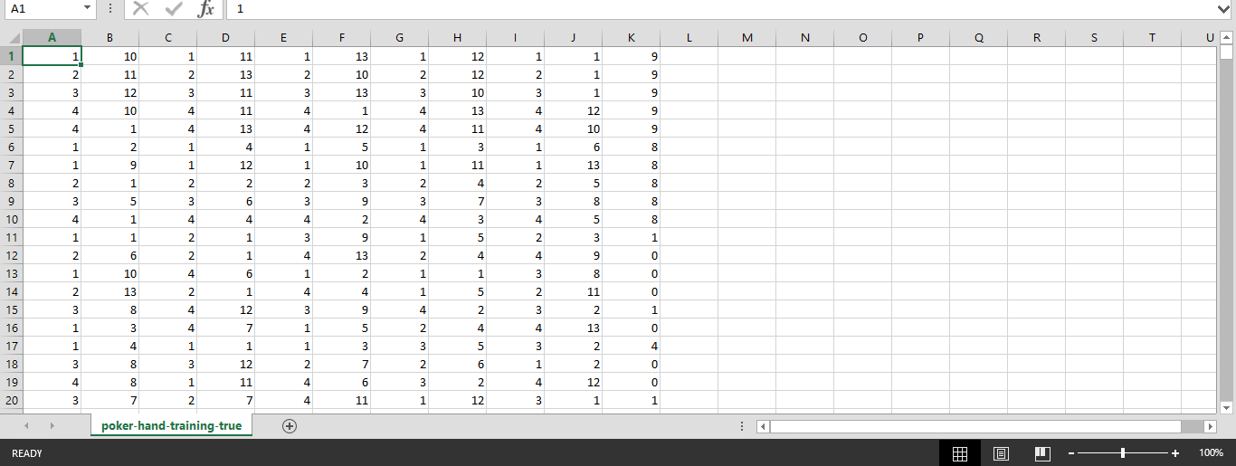
Poker Hand Dataset

Slide 8
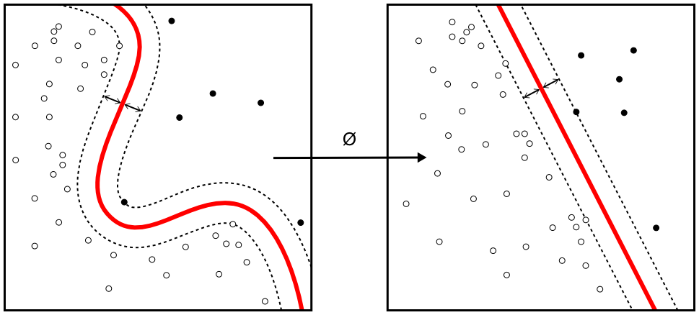
Algorithm
This machine uses the support vector clustering (SVC) extension of the support vector machine algorithm.
SVC is similar to SVM but also builds on kernel functions.
It is more appropriate for data science.

Slide 9
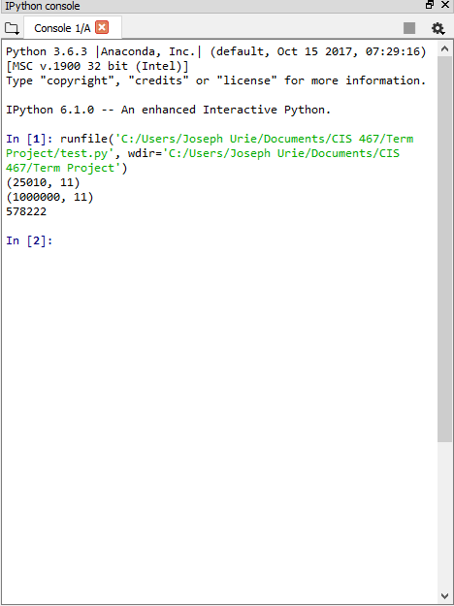
Results
The results are not final, further investigation will potentially lead to better accuracy.
When tested 1,000,000 times, the current machine guessed correctly 578, 222 times (57.8%)

Slide 10
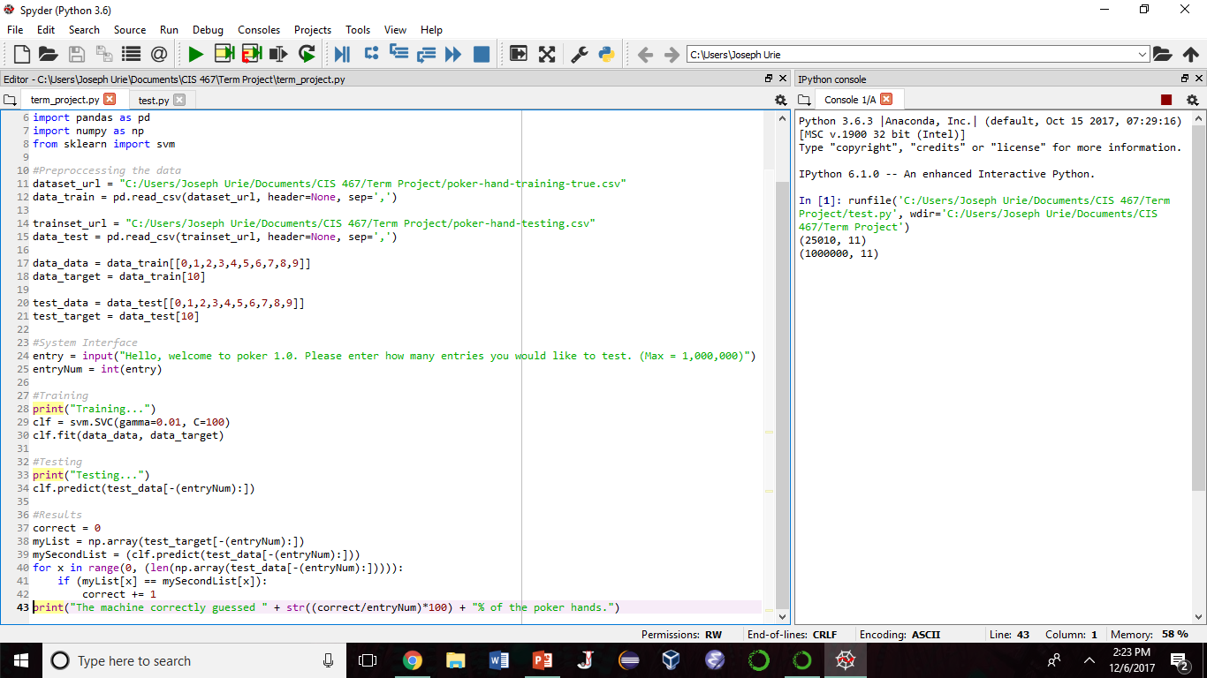
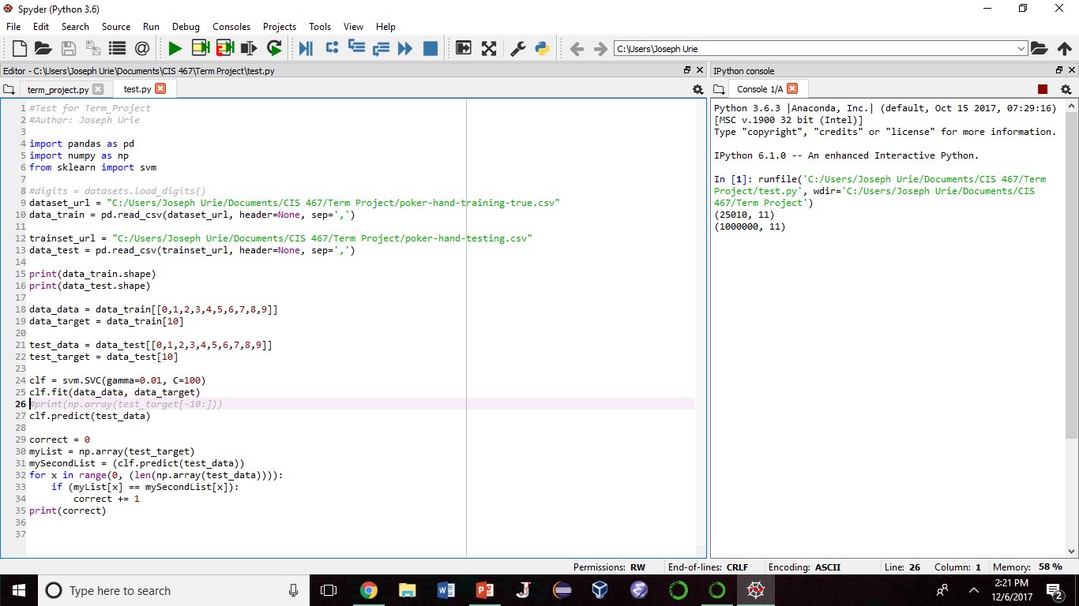
Source Code

Slide 11

Looking Forward
Again, results are not final.
Learning doesn’t happen in one month…
Given the opportunity, I would continue research.

